Slide 1
Parts of an insect

Slide 2
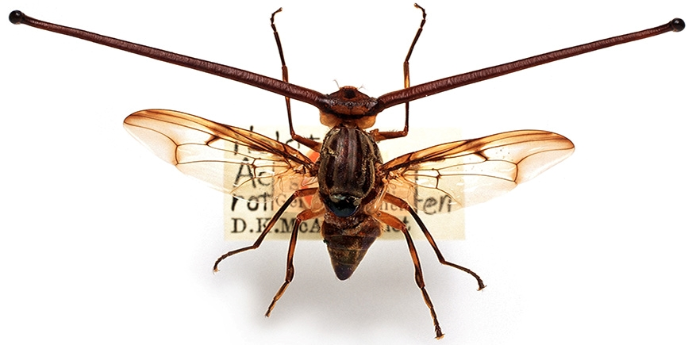
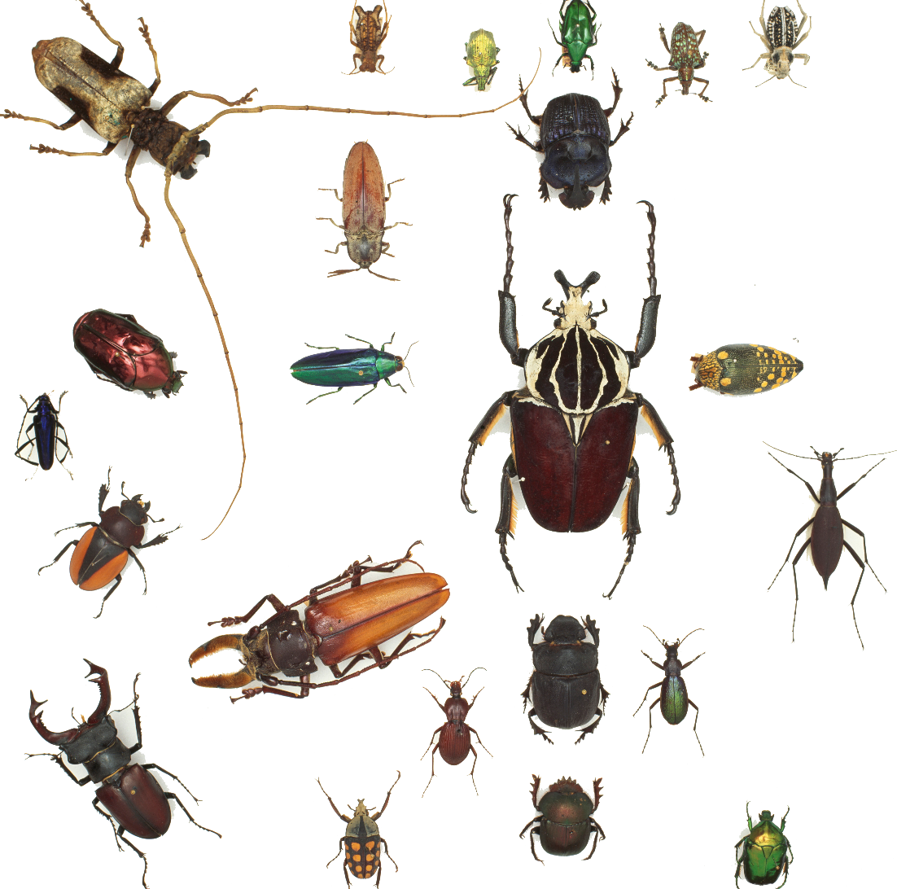
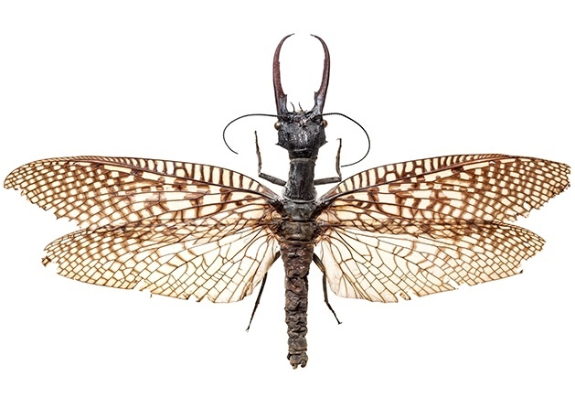
Insects come in all shapes and sizes
Parts of an insect
Rothschild’s fly (Achias rothschildi)
Dobsonfly (Acanthacorydalis fruhstorferi)
Beetles from around the world
Photos © The Trustees of the Natural History Museum

Slide 3
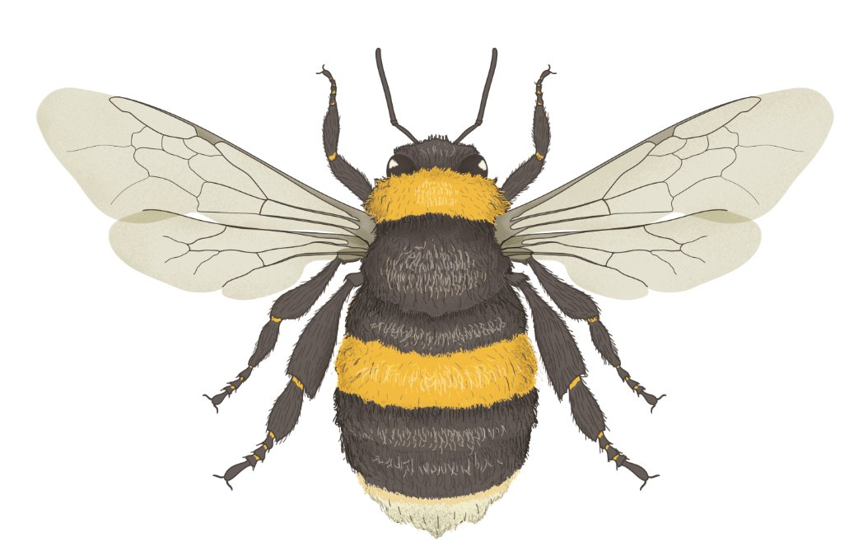
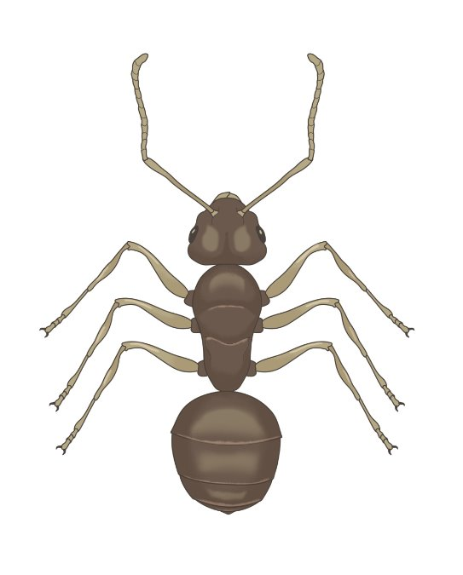
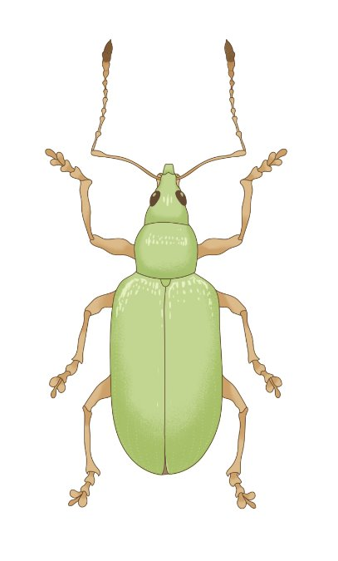
Do you recognise any of these insects?
Parts of an insect
Bumblebee
Ant
Beetle

Slide 4
What do these insects have in common?
Parts of an insect

Slide 5
Six legs
Parts of an insect
3
4
2
5
1
6

Slide 6
3 main body parts
Parts of an insect
Head
Thorax
Abdomen

Slide 7
Antennae (singular: antenna)
Parts of an insect

Slide 8
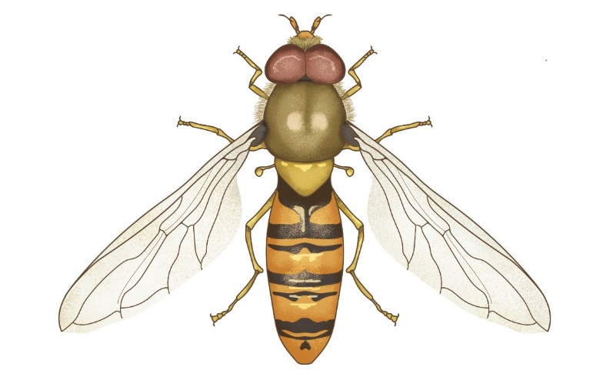
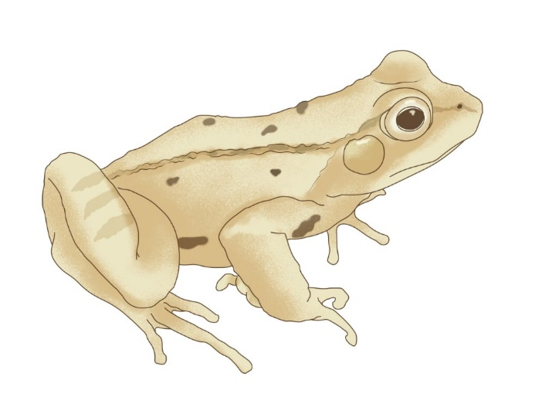

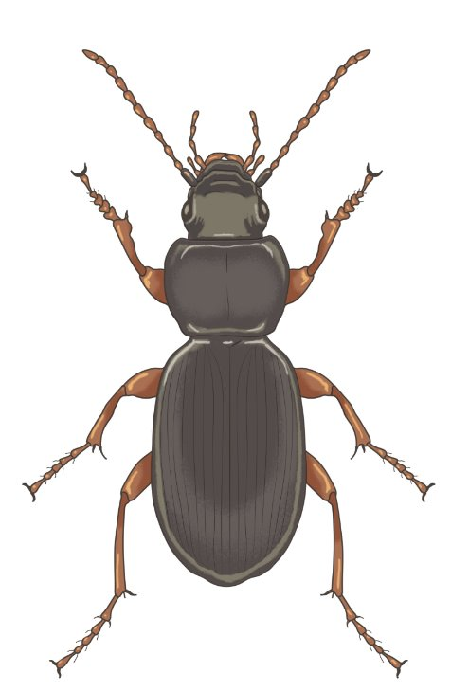
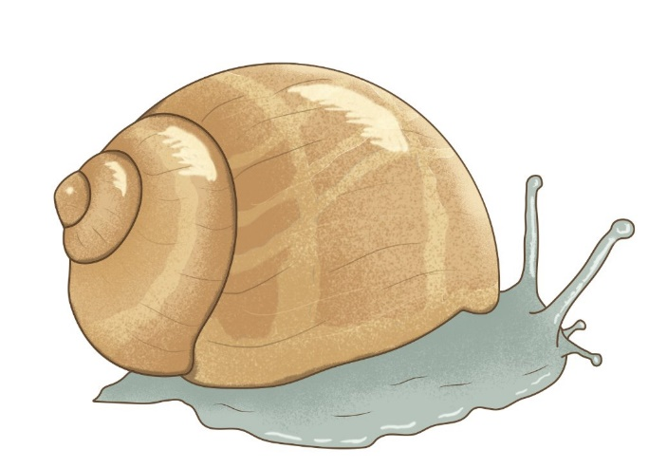
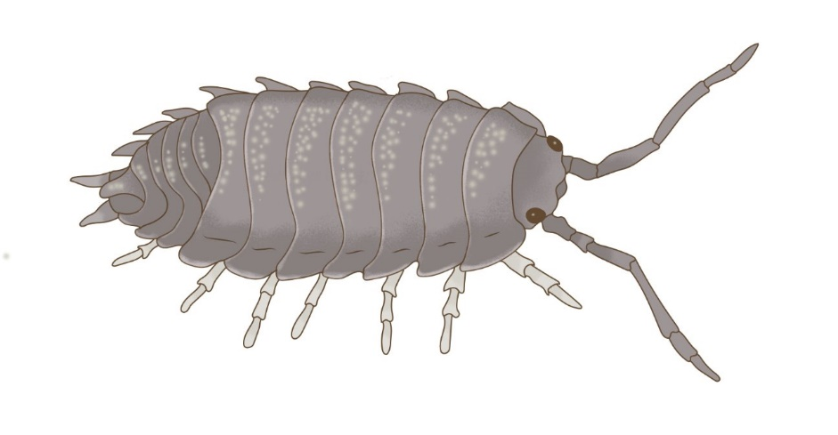
Which of these animals are insects?
Parts of an insect

Slide 9

These are insects!
Parts of an insect

Slide 10
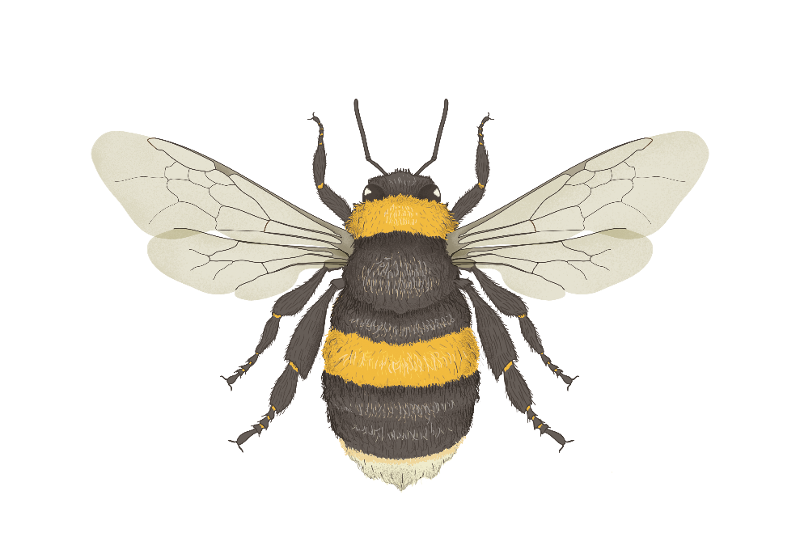
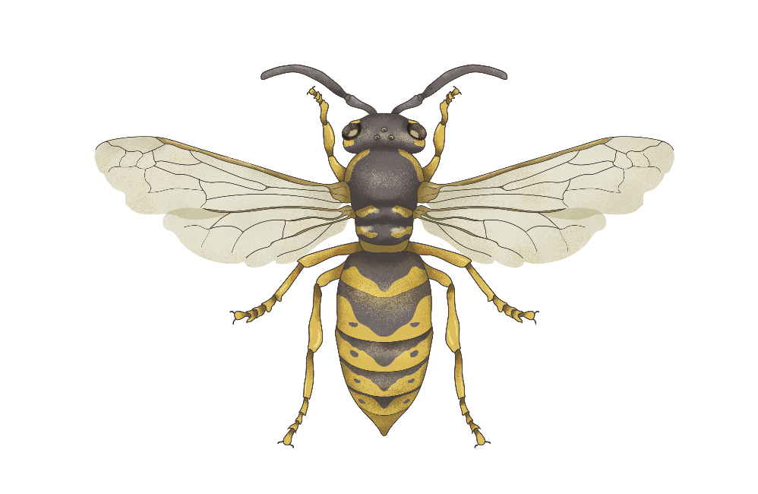
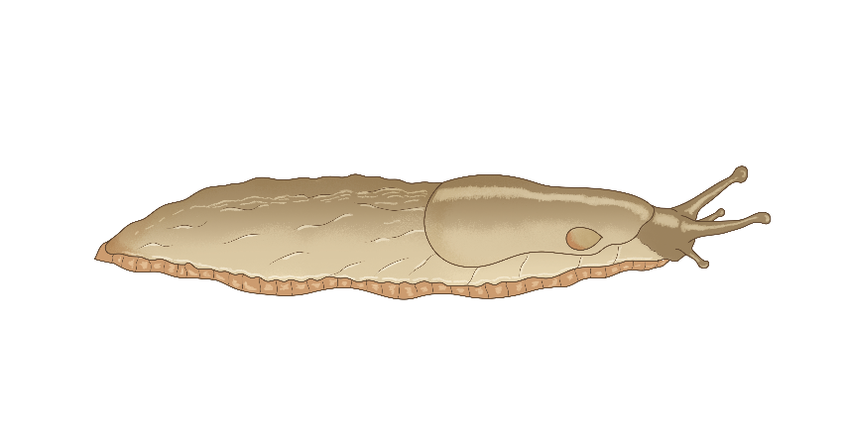
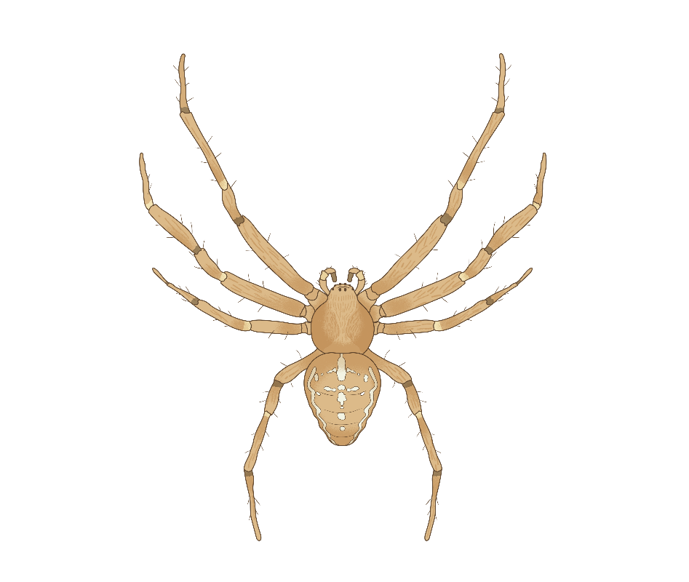
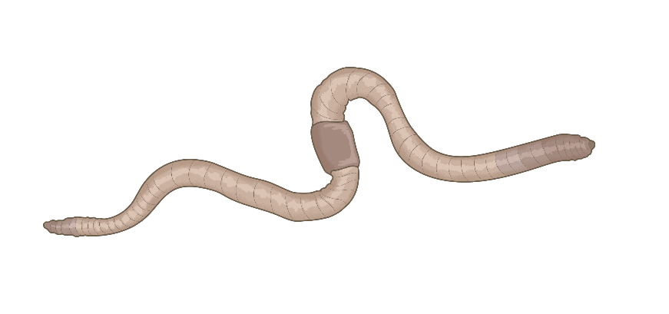
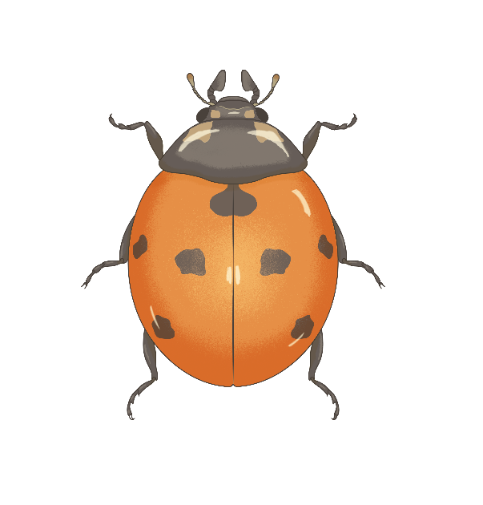
Which of these animals are insects?
Parts of an insect

Slide 11
These are insects!
Parts of an insect

Slide 12
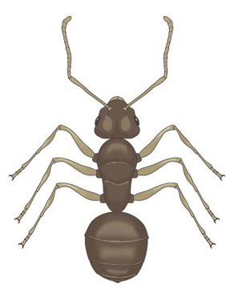
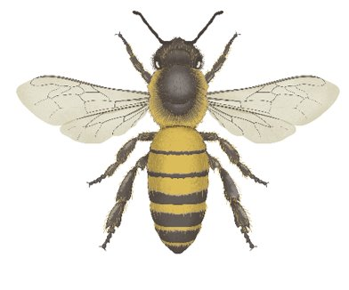
Parts of an insect
Label the parts of the insects on the worksheet.​
Research different types of ladybird in the UK and colour in the picture to match your favourite one.​
Antenna
Head
Wing
Thorax
Abdomen
Legs

Slide 13
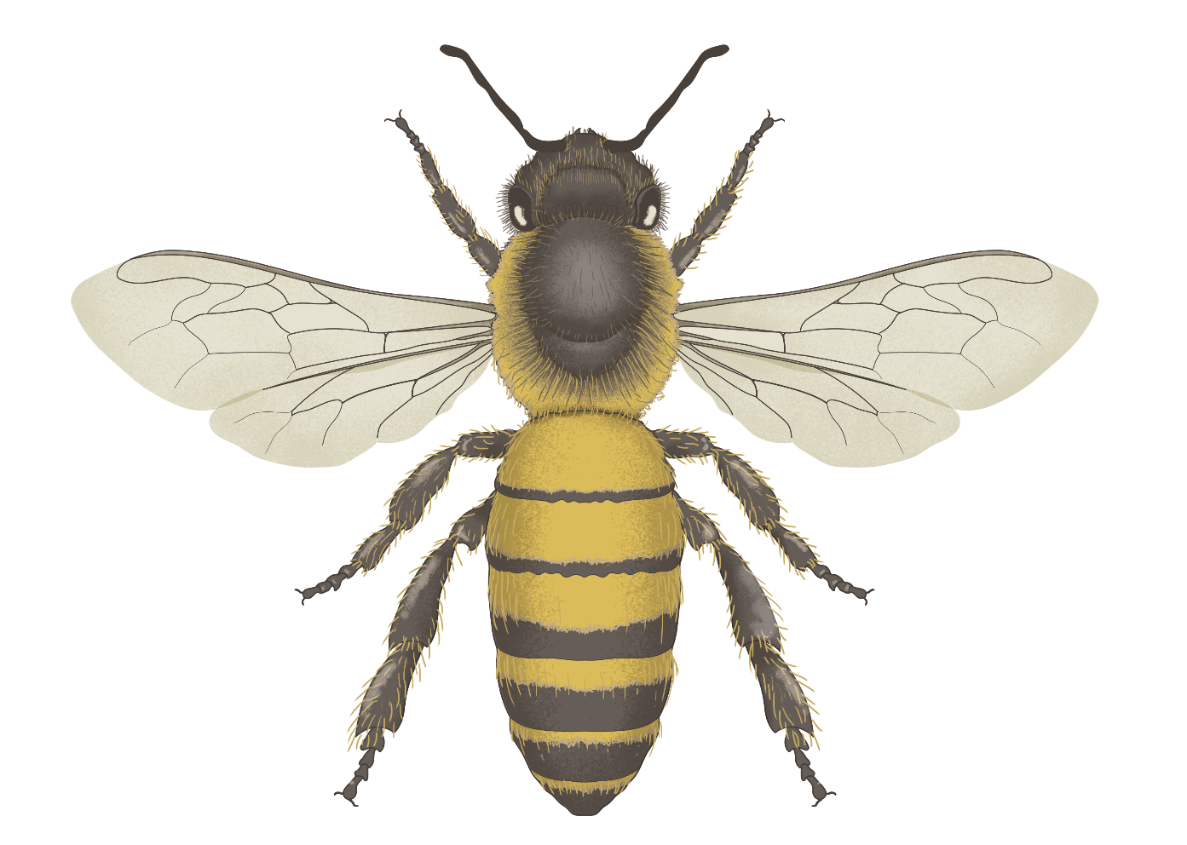
Parts of a honeybee
Antenna
Head
Thorax
Wings
Abdomen
Notes:
Feel free to use these insect illustrations in the worksheet instead.

Slide 14
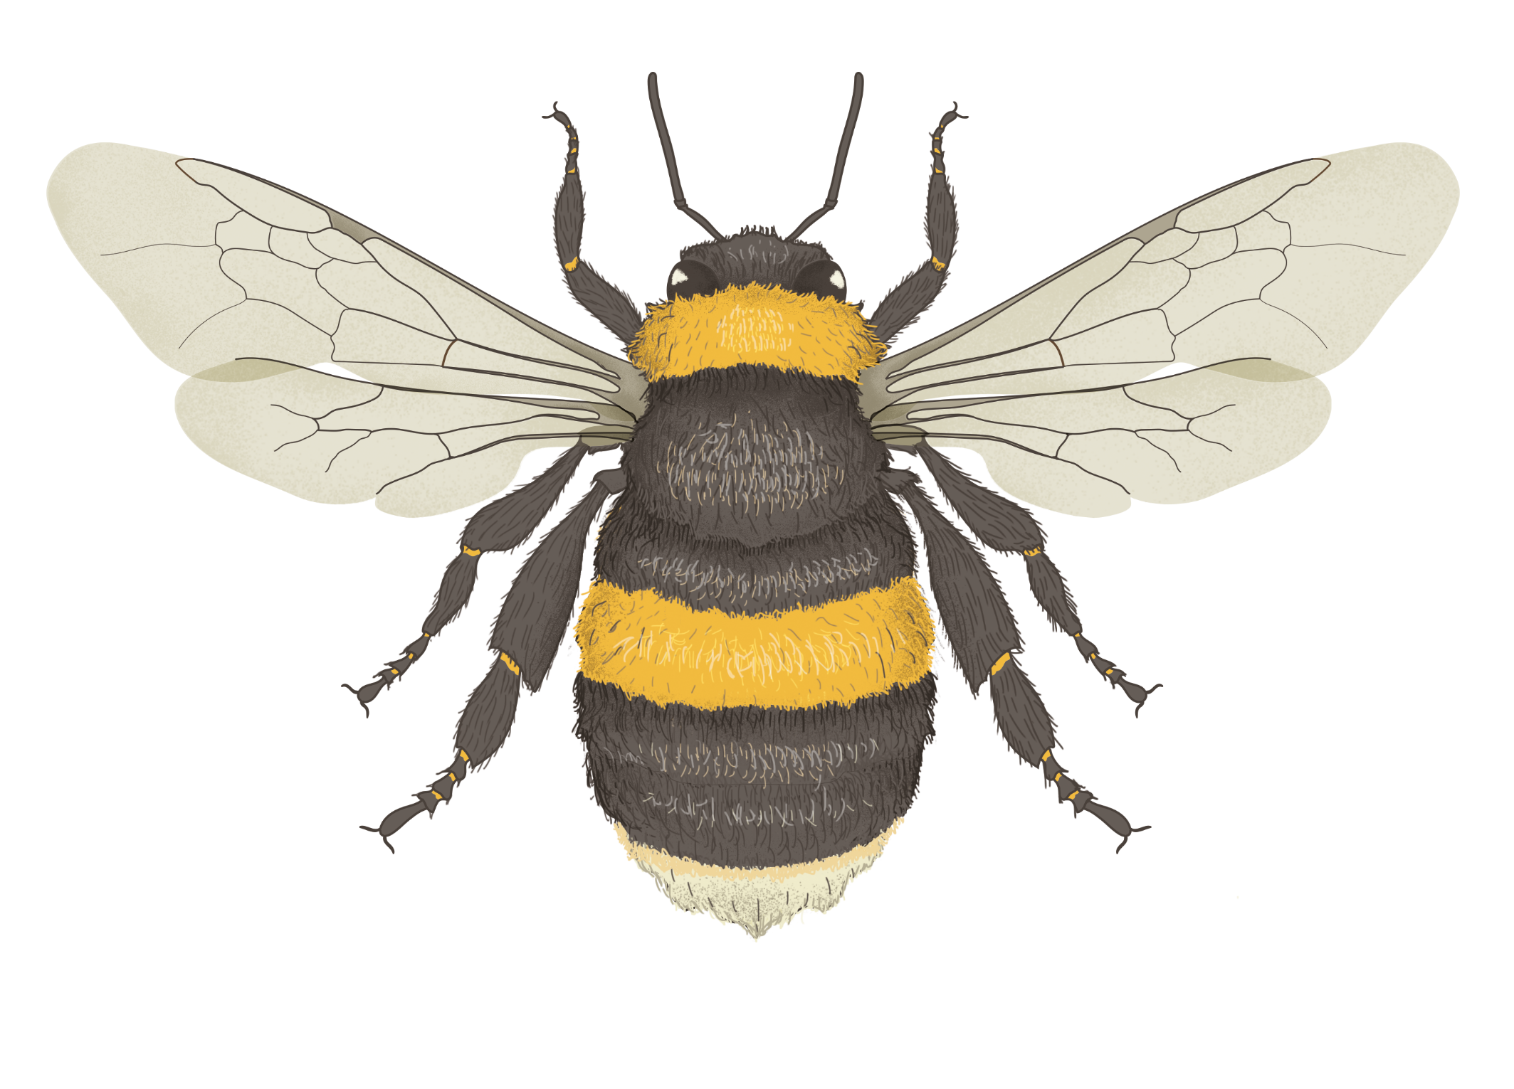
Parts of a bumblebee
Antenna
Head
Thorax
Wings
Abdomen
Notes:
Feel free to use these insect illustrations in the worksheet instead.

Slide 15
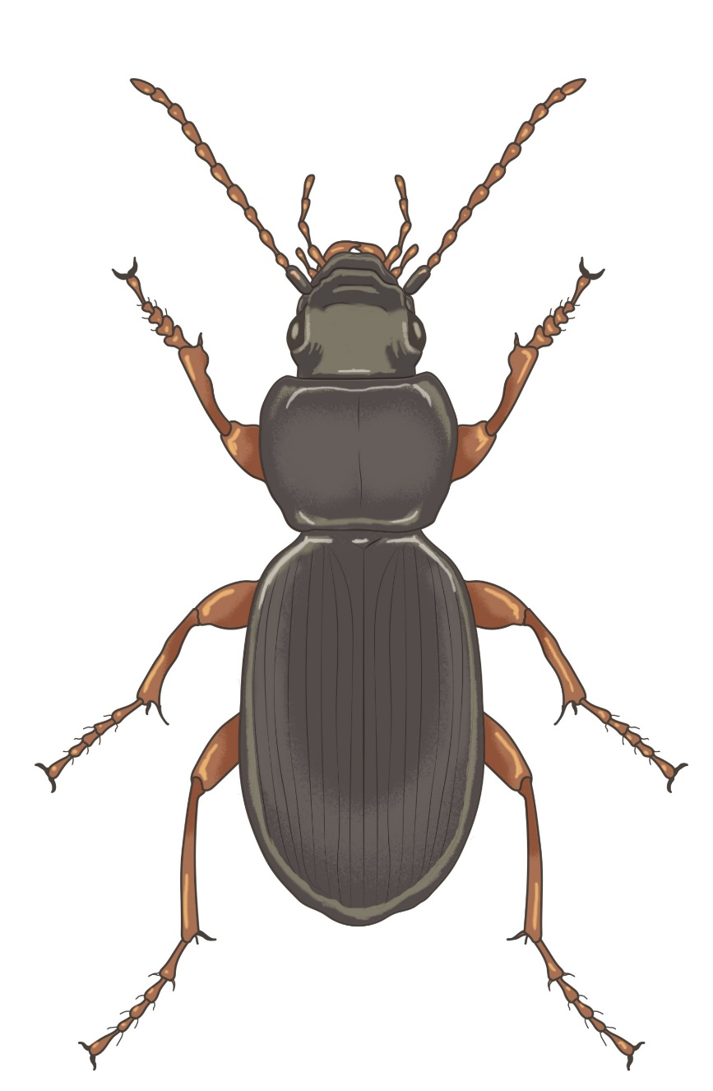
Parts of a ground beetle
Maxillary palp
Antenna
Head
Thorax
Pronotum
Abdomen
Shell/Elytra
Notes:
Feel free to use these insect illustrations in the worksheet instead.
In most beetles, the first section of the thorax is protected by a wide shield called the ‘pronotum’
Beetles often have special feelers called ‘maxillary palps’. These are shorter than the antennae and help the beetle sense their food.

Slide 16
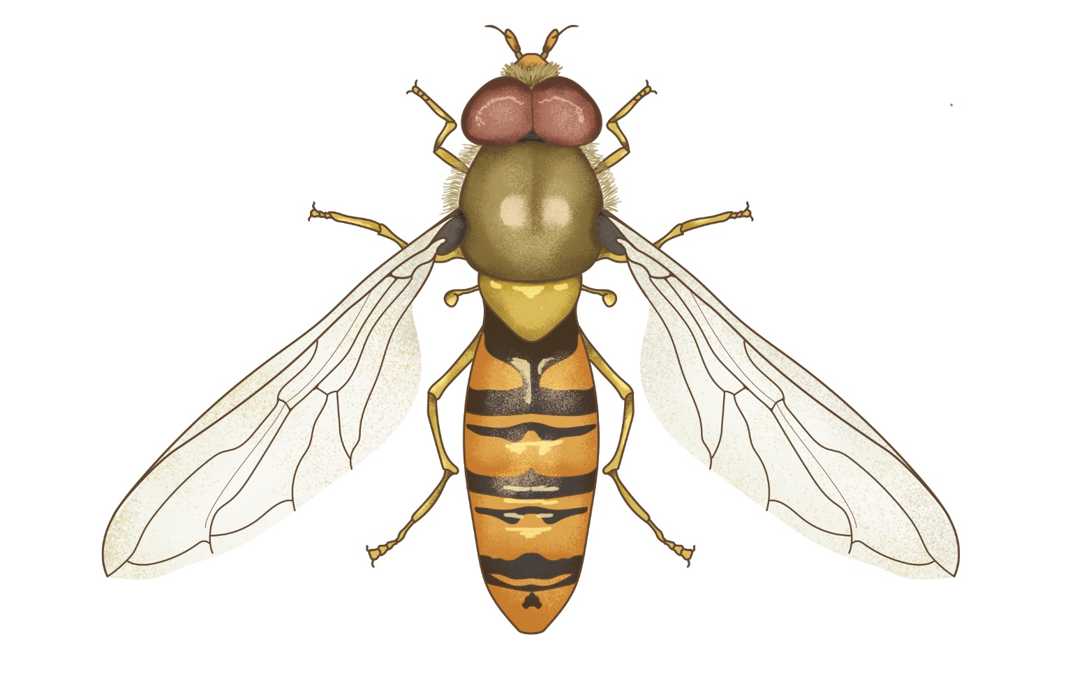
Parts of a hoverfly
Antenna
Head
Thorax
Haltere
Abdomen
Wing
Notes:
Feel free to use these insect illustrations in the worksheet instead.

Slide 17
We hope you found this resource useful!
Send your feedback to school-bookings@nhm.ac.uk
This resource was produced with support from Evolution Education Trust.

